Slide 1




Arowwai Industries
WINE QUALITY
PROJECT
www.reallygreatsite.com

Slide 2

Overview
Business Problem
Objectives
KPIs
Methodology
EDA
Key Insights
Recommendations
Conclusion
01
02
03
04
05
06
07
08

Slide 3


Business Problem
The goal of the wine quality classification project is to help businesses in the wine industry (such as wineries, distributors, retailers, and quality control labs) assess and predict the quality of wines based on various chemical and sensory attributes.

Slide 4

Business Objectives
1
Quality Assurance and Control: Wineries face challenges in ensuring the consistent quality of their wine products. There might be variations in the quality of wine produced from batch to batch due to differences in grape harvest, processing conditions, and storage practices.
2
Consumer Preference Matching: Retailers and distributors need a reliable way to categorize wines into quality classes to match consumer preferences and price points. Consumers may have varying preferences based on wine quality, and a business may struggle to provide the right products that meet market demand.
3
Operational Efficiency in Production: Understanding the quality of wine based on certain chemical properties allows wineries to adjust their production process (e.g., fermentation time, sugar levels, sulfur dioxide usage) to optimize product quality, thereby reducing waste and increasing profitability.

Slide 5






KPIs
Measures of perfromance that this project will facilitate the organisation to reach.
Accuracy
Efficiency
Growth
Customer satisfaction
Compliance

Slide 6




Methodology
Data
Data extracted from Kaggle’s large database of datasets.
Model
Classification models: Logistic Regression, Random Forest Classifier and KNearest Neighbors.
Model Performance
Captures the probability that a model will accurately predict wine classification.

Slide 7

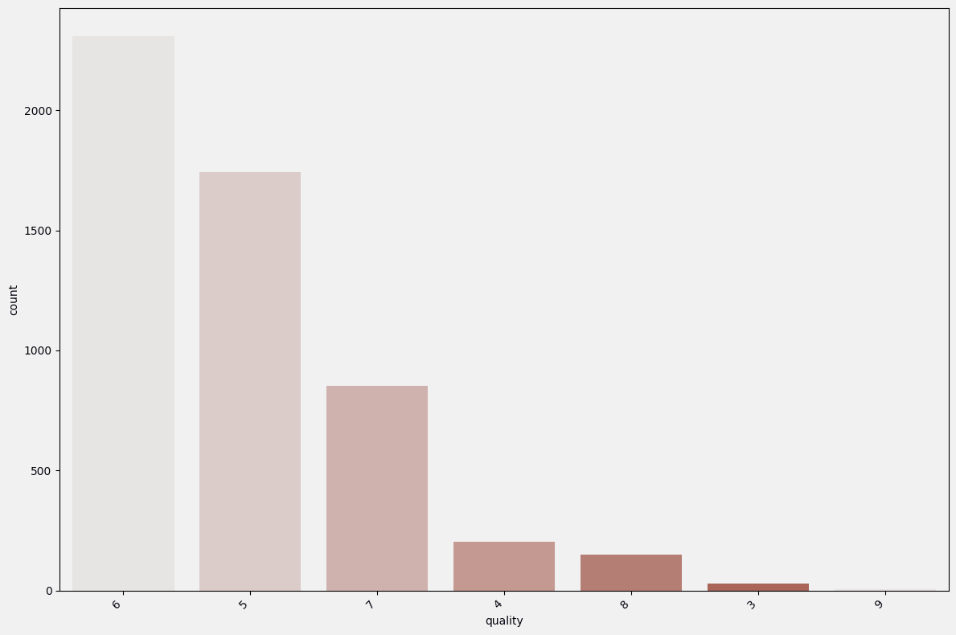
EDA
50%
Class 6
0.9%
Class 9
7
Categories

Slide 8




Concept In Business
Quality 6 has majority of the entries in this dataset, followed closely 5 and 7. It is also to be noted that class 9 has a very low number of entries.

Slide 9

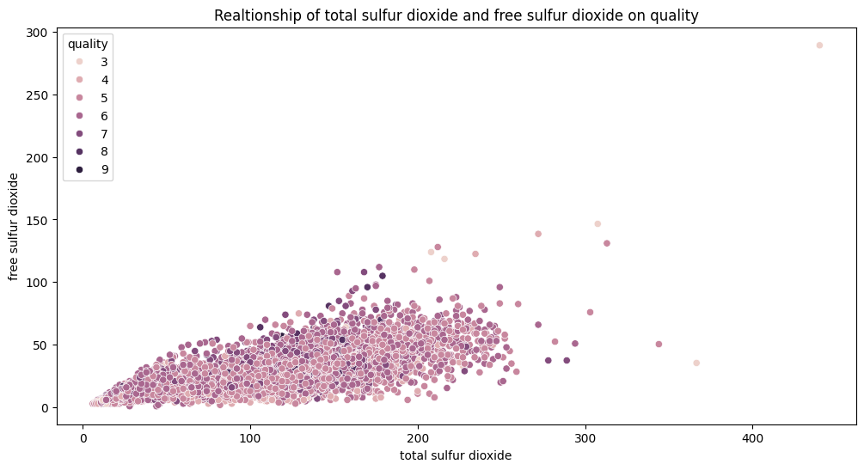
Exploratory Data Analysis

Slide 10





Total sulfur dioxide
100-300
Total sulfur dioxide has more influence on the class of a wine category than free sulfur dioxide.

Slide 11

Key Insights
Each categoty of wine classification has different wine properties that ingluence their class.
2. Wine properties vary in degree of influence they have on each class of wine.

Slide 12

Recommendations
Forecast for prediction
2. Wine matching for retailers
3. Customer feedback and quality metrics
4. Sustainability and waste reduction

Slide 13








THANK YOU
Gerente General

